Slide 1

Anaphora and co-reference resolution

Slide 2
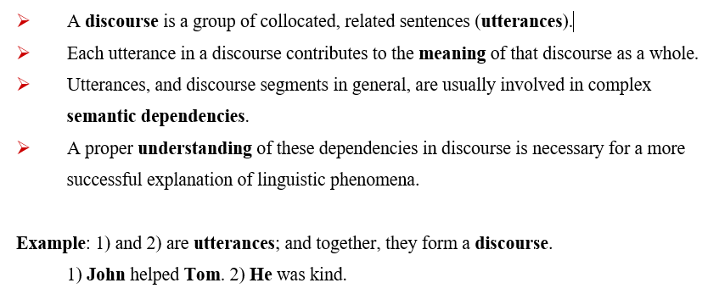
Anaphora and co-reference resolution

Slide 3
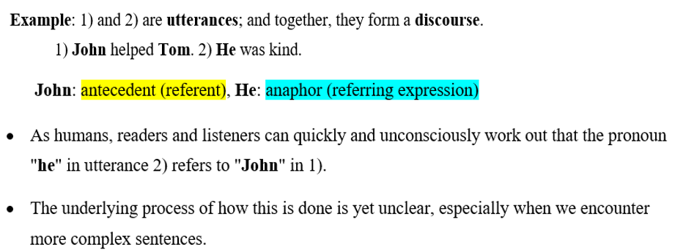

Slide 4
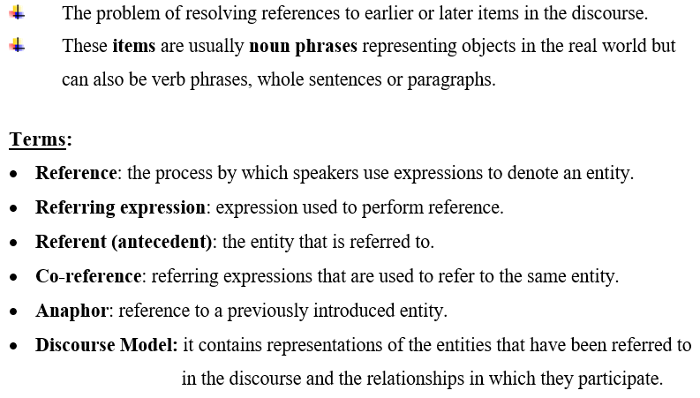
Anaphora Resolution (AR)

Slide 5
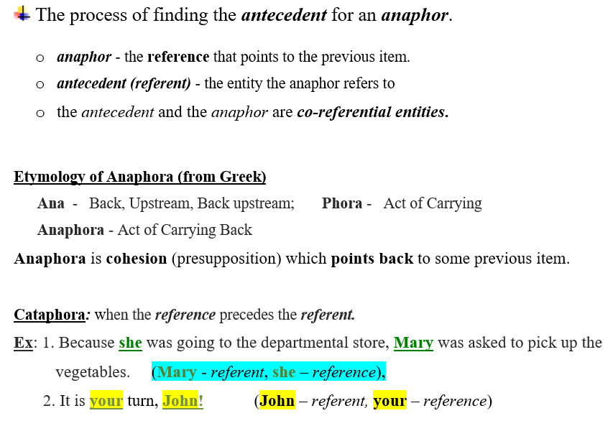
What is Anaphora Resolution?

Slide 6
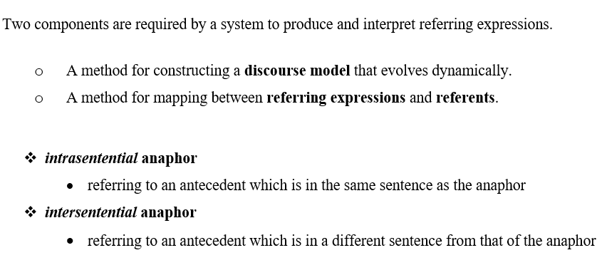

Slide 7
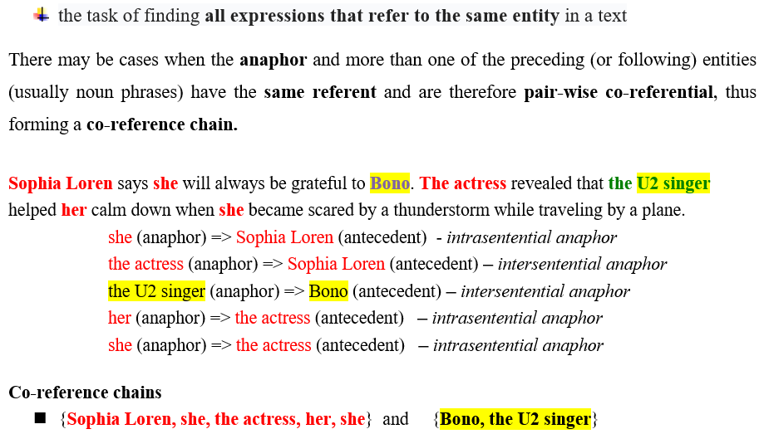
Co-reference resolution

Slide 8
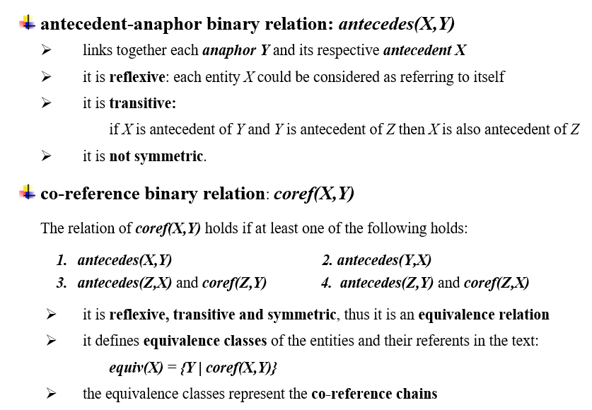
Co-reference chains – formal definition

Slide 9
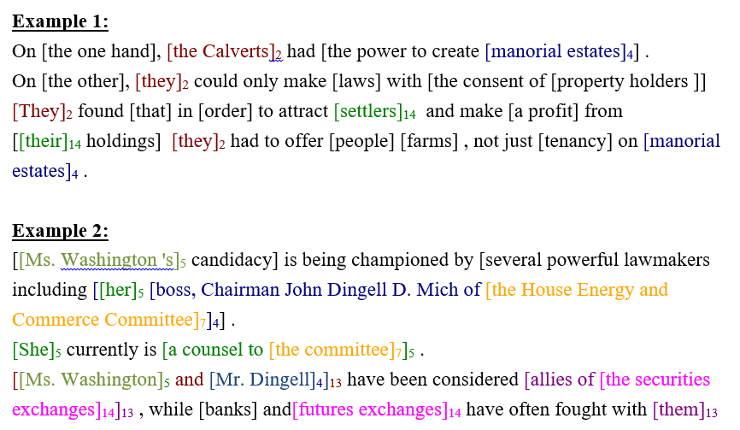
Co-reference chains

Slide 10
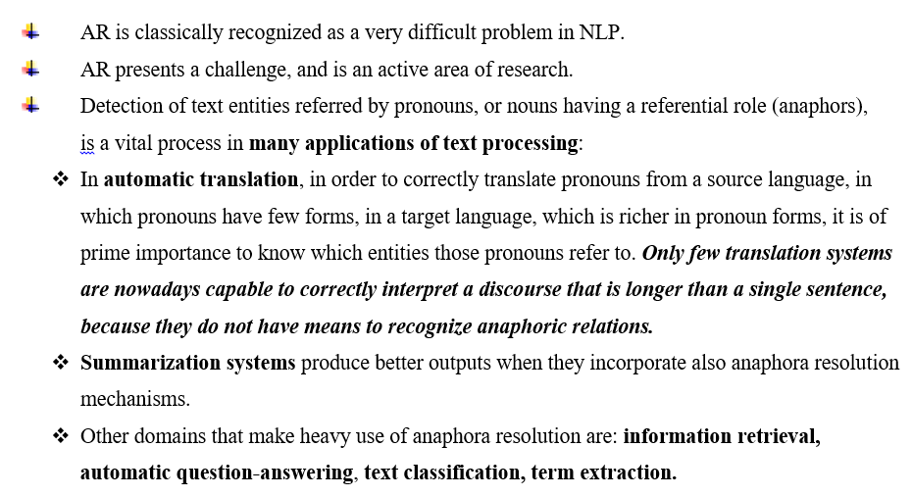
Anaphora Resolution in other NLP tasks

Slide 11
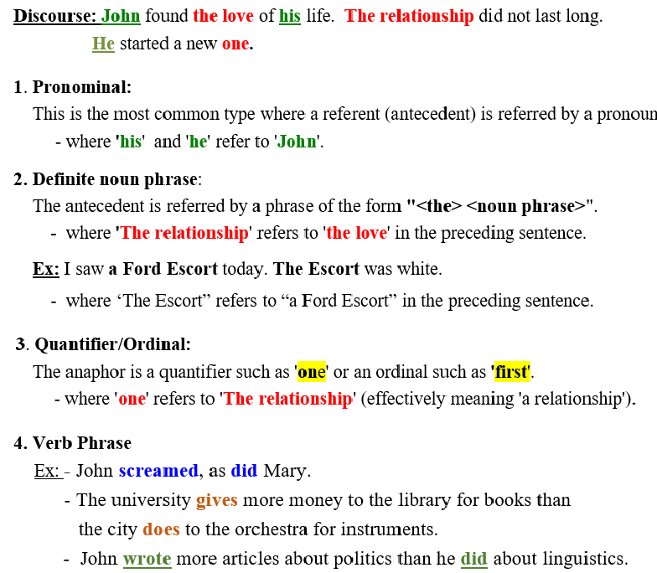
four types of anaphor

Slide 12
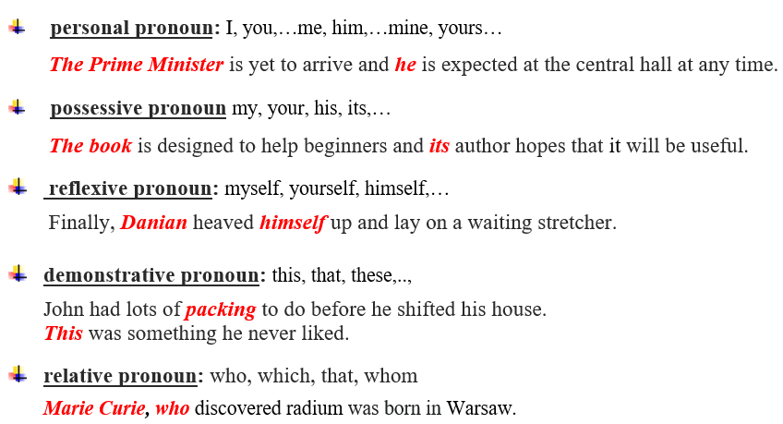
Pronominal anaphor

Slide 13
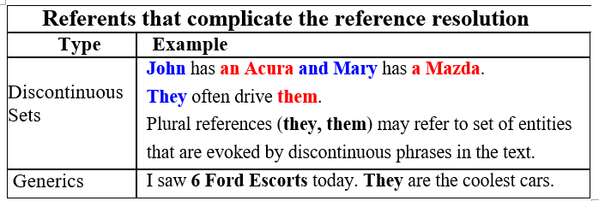
Other types of anaphor

Slide 14
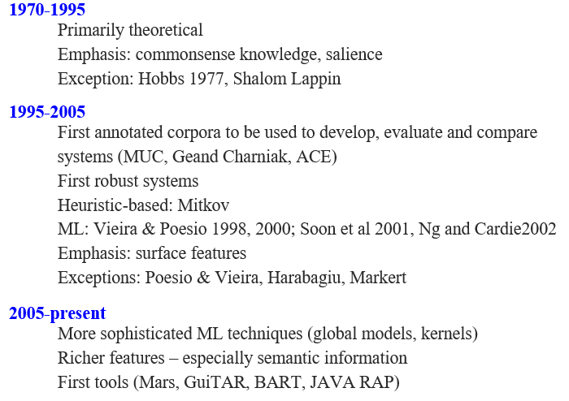
RESEARCH ON ANAPHORA RESOLUTION

Slide 15
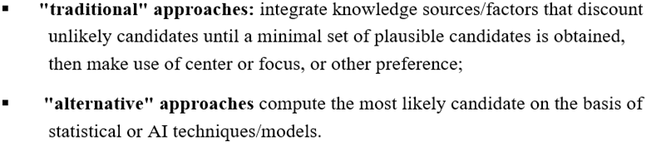
Approaches for anaphora resolution

Slide 16
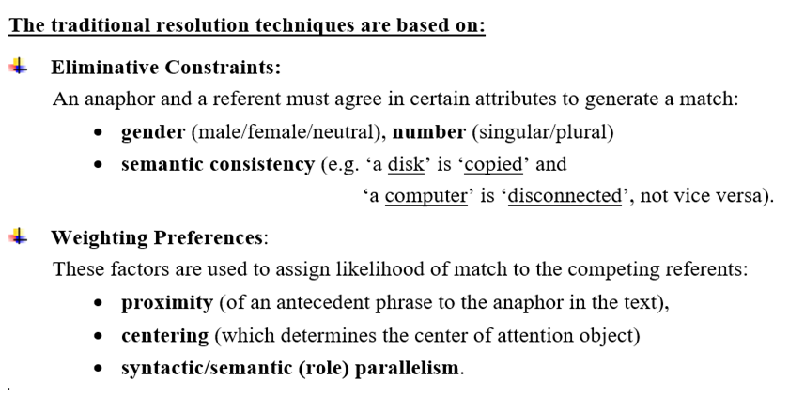

Slide 17
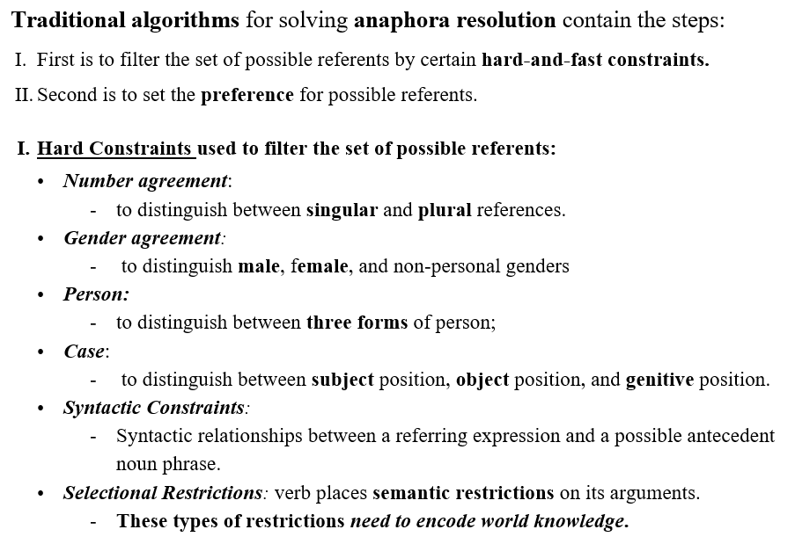

Slide 18
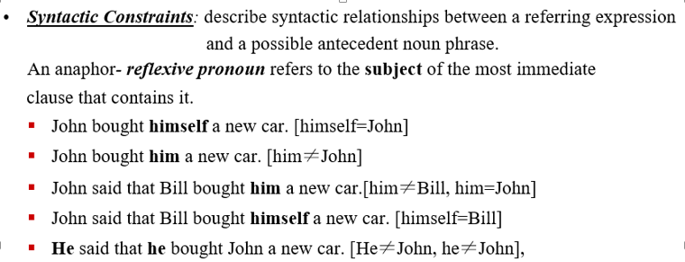
Hard Constraints

Slide 19
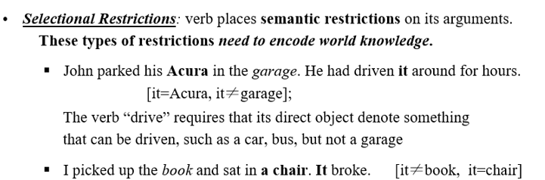
Hard Constraints

Slide 20
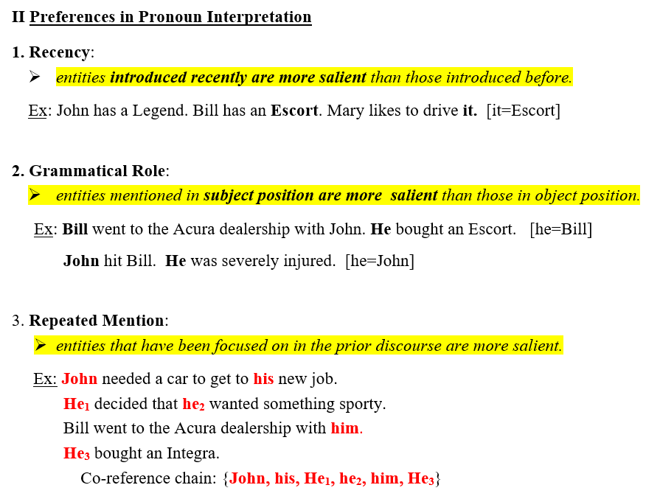
Graph-based Ranking Algorithm

Slide 21
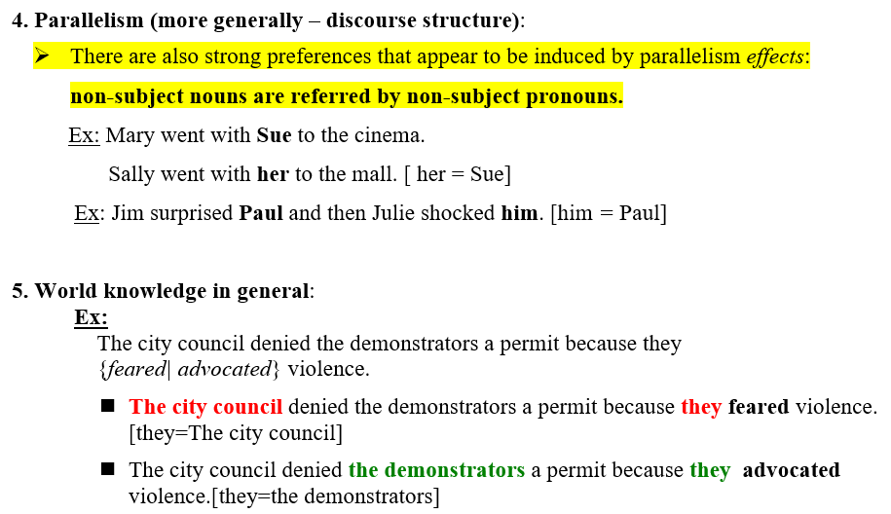
Preferences in Pronoun Interpretation (contd.)

Slide 22
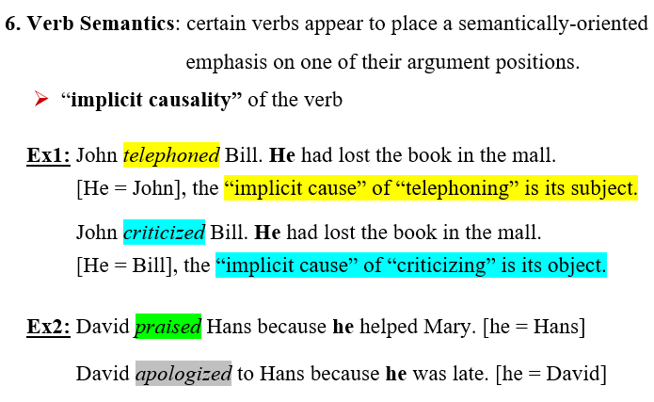
Preferences in Pronoun Interpretation (contd.)

Slide 23
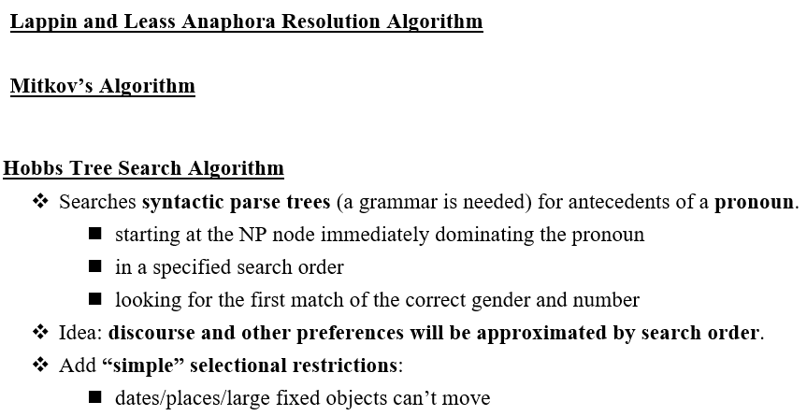
Algorithms based on traditional approaches

Slide 24
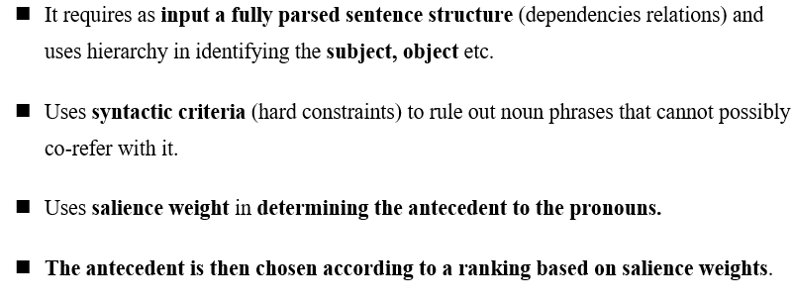
Lappin and Leass Algorithm

Slide 25
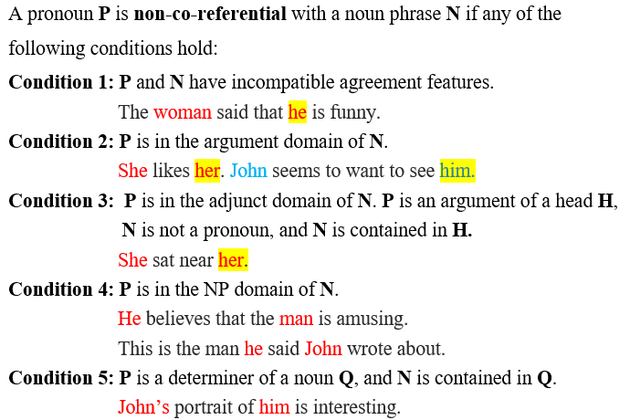
Lappin and Leass Algorithm (contd.) - syntactic criteria (hard constraints)-

Slide 26
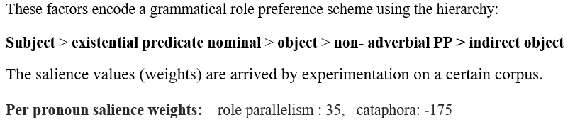
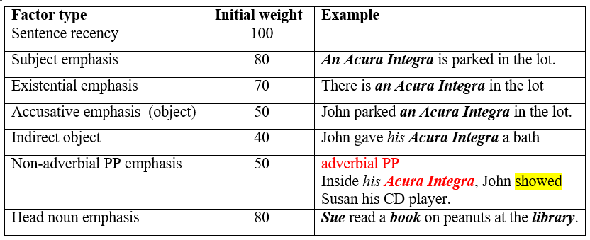
Salience factor types with initial weights

Slide 27
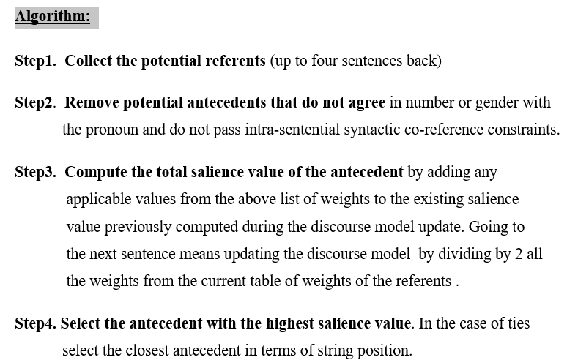

Slide 28
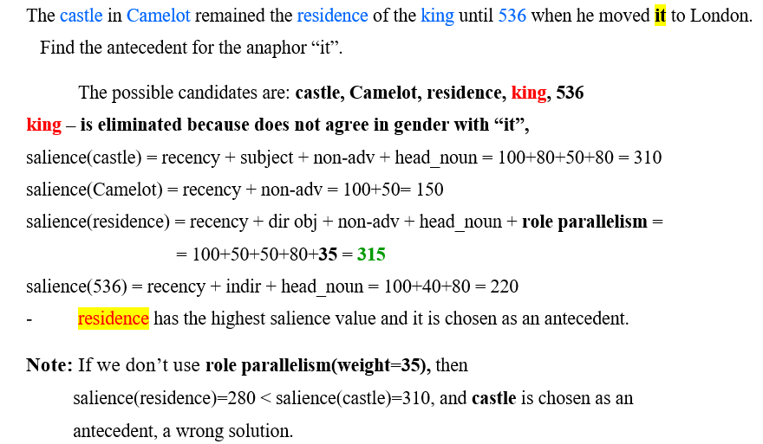
Example 1 (Lapin and Less alg.)

Slide 29
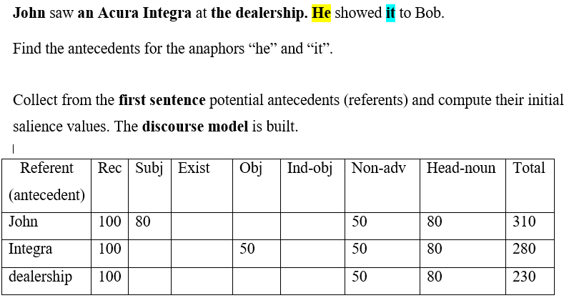
Example 2 (Lapin and Less alg.)

Slide 30
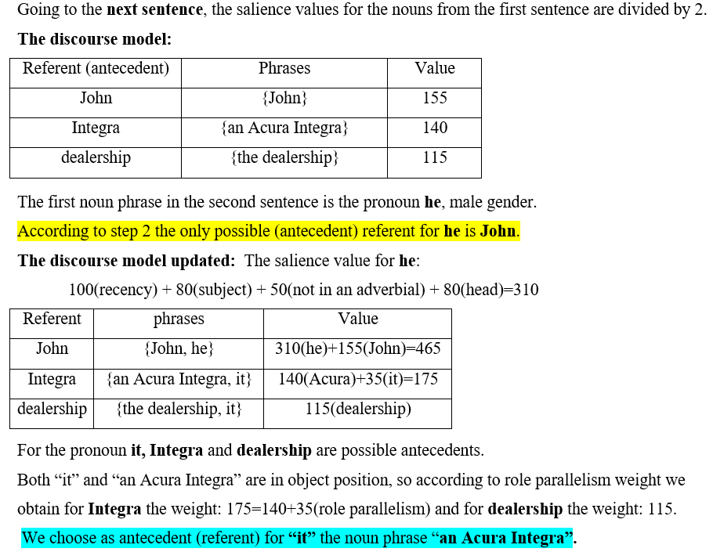
Example 2 (contd.)

Slide 31
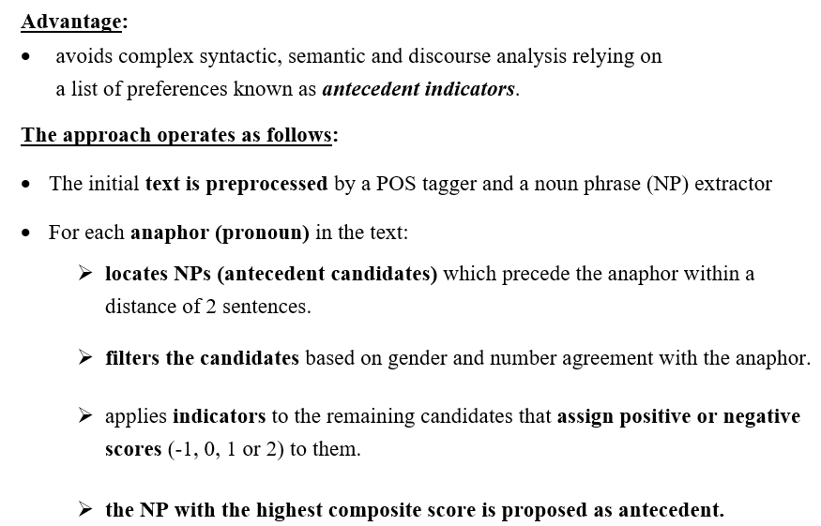
Mitkov’s Anaphora Resolution System

Slide 32
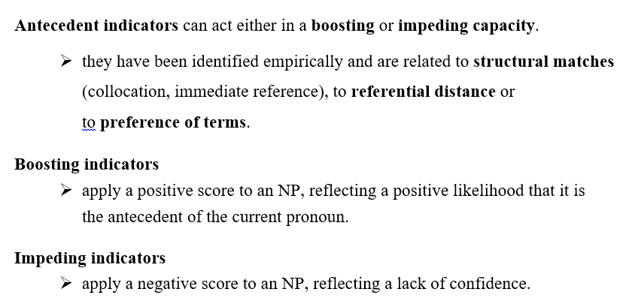

Slide 33
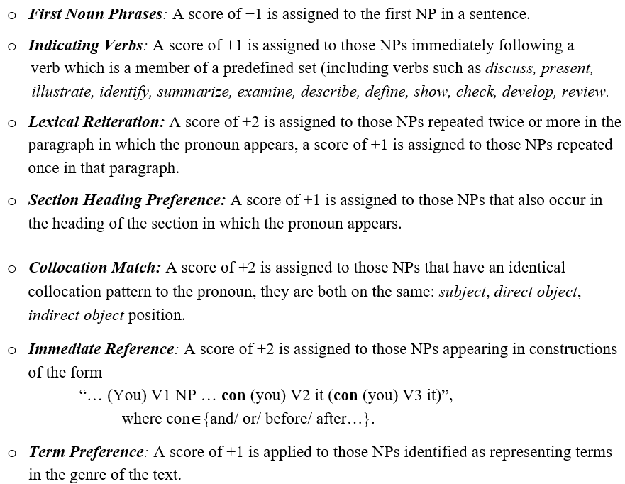
Boosting indicators

Slide 34
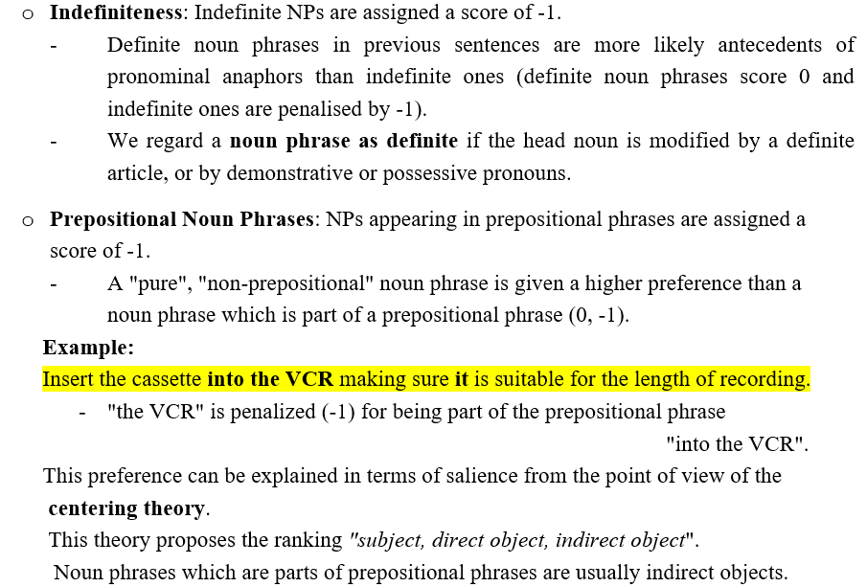
Impeding indicators

Slide 35
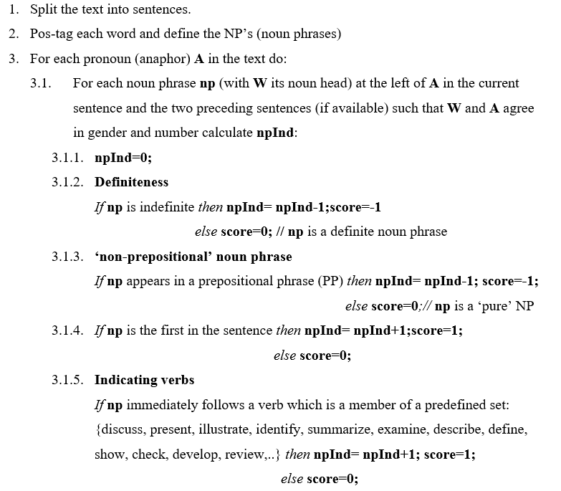
Mitkov’s algorithm step by step

Slide 36
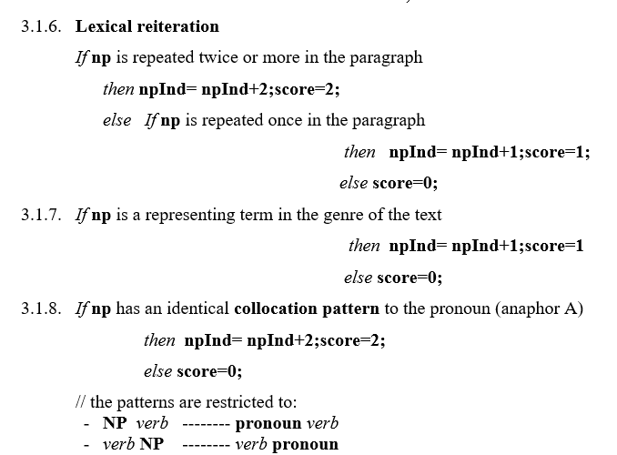
Mitkov’s algorithm step by step (contd.)

Slide 37
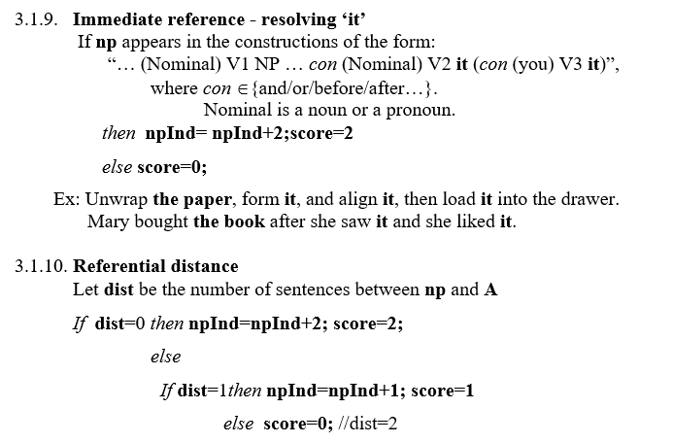
Mitkov’s algorithm step by step (contd.)

Slide 38
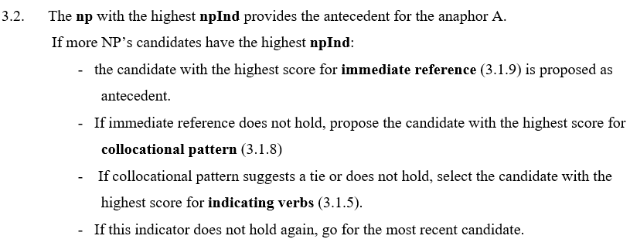
Mitkov’s algorithm step by step (contd.)

Slide 39
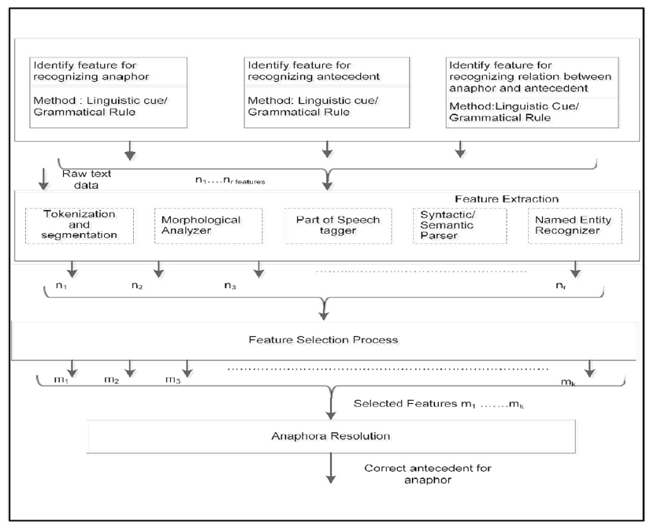
Anaphora resolution system – a machine learning approach

Slide 40
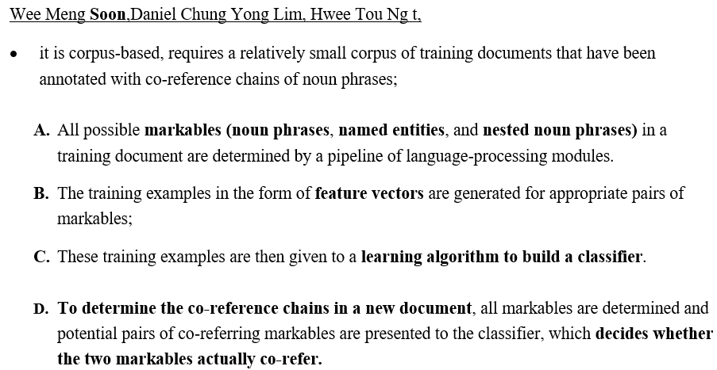
A Machine Learning Approach to Co-reference Resolution of Noun Phrases

Slide 41
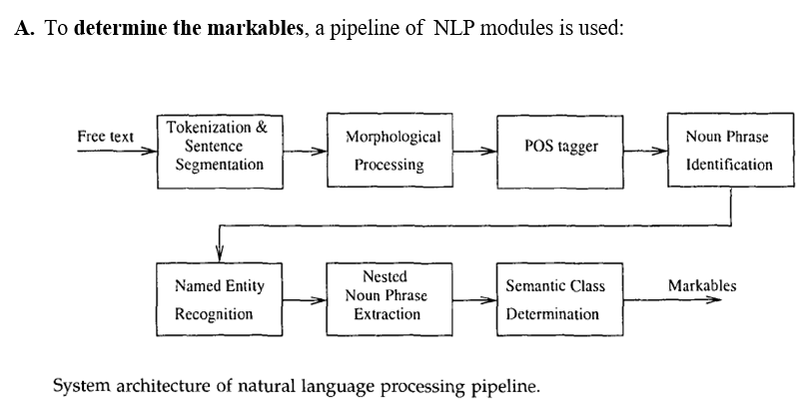

Slide 42
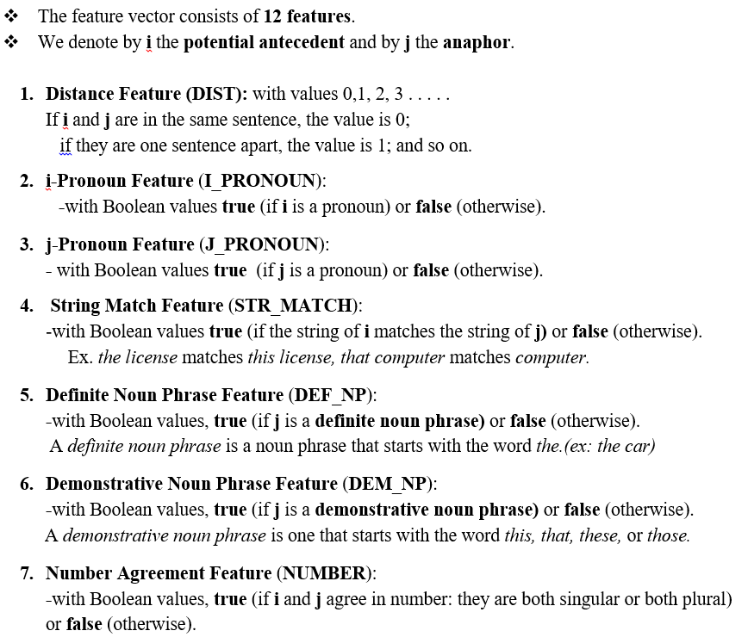
B. Determination of Feature Vectors

Slide 43
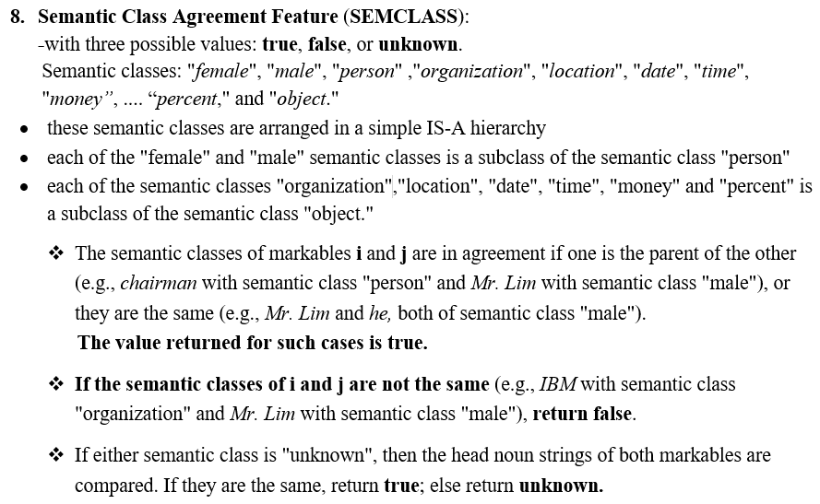
B. Determination of Feature Vectors (contd.)

Slide 44
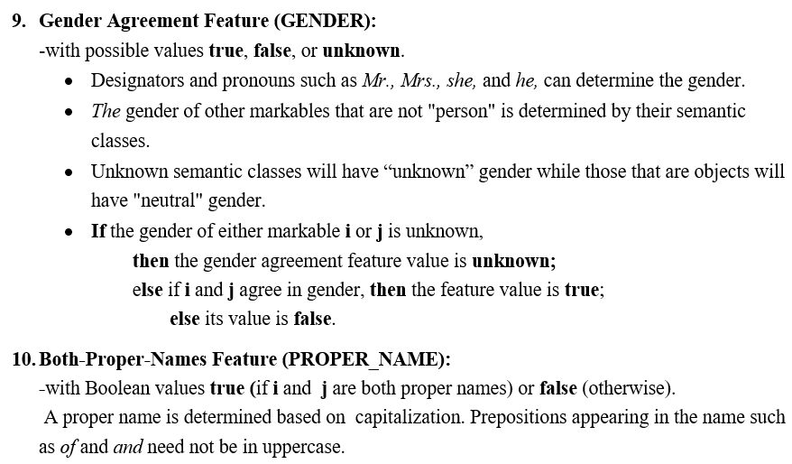
B. Determination of Feature Vectors (contd.)

Slide 45
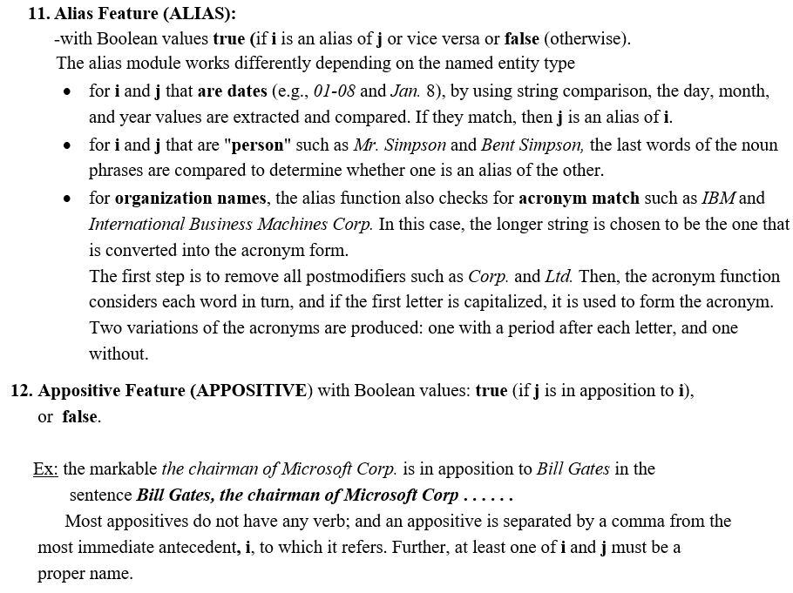

Slide 46
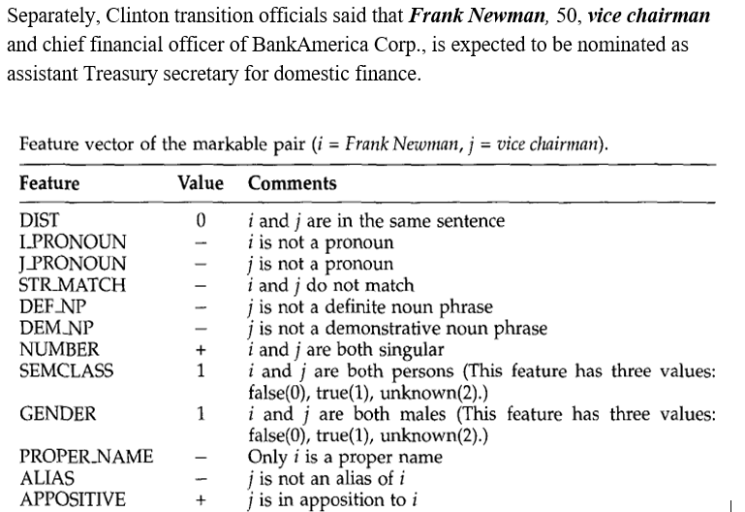
Feature vector - example

Slide 47
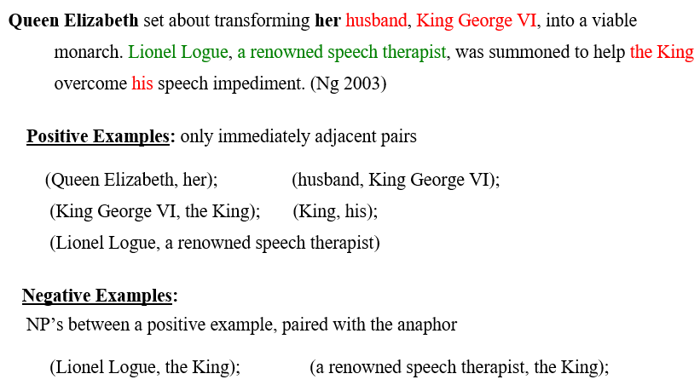
B. Generation of Training Data

Slide 48
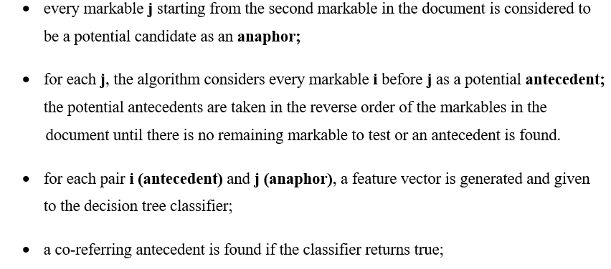
The co-reference resolution algorithm based on a decision tree classifier

Slide 49
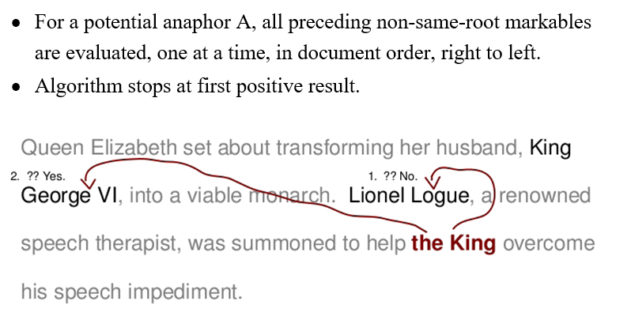
Testing method

Slide 50
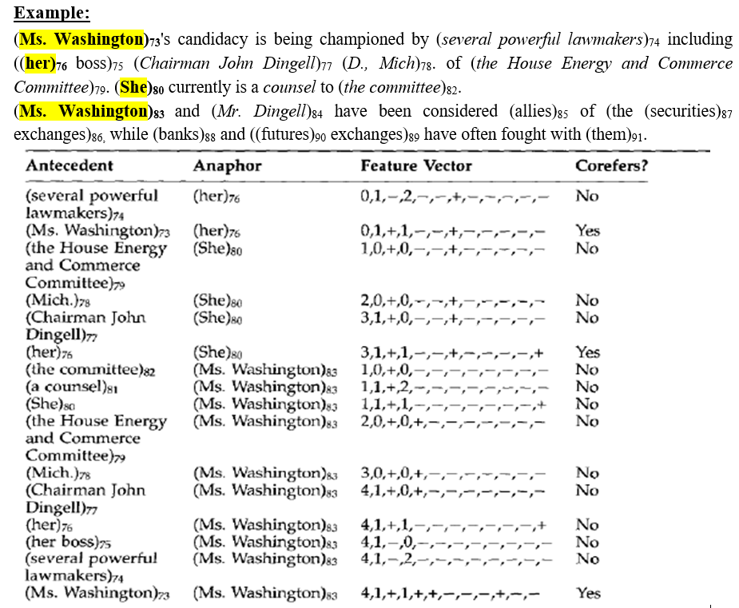

Slide 51



Slide 52


Slide 53





Datasets for coreference Resolution
https://paperswithcode.com/datasets?task=coreference-resolution

